Slide 1


How to Run
Reproducible Visual SLAM Experiments
Zichao Zhang, Davide Scaramuzza
Notes:
Today I am mostly going to talk about the evaluation of visual SLAM experiments. To understand what do we need to do to achieve this goal, let’s first look at the process of visual SLAM experiments.

Slide 2
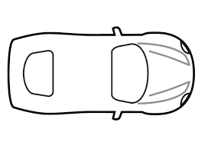
SLAM Experiments
Sensor (e.g., camera)
Groundtruth provider (e.g., GPS)
Hand-eye Transformation
After the hand-eye transformation:
Quantitative Evaluation
error
Notes:
Usually, we have our sensor mounted on a moving platform, here is a car, also there is something that provides the groundtruth, for example, gps.
Then the platform will move along some trajectory, we get the groundtruth from the GPS and the sensor measurements, then we apply visual SLAM algorithm to get the estimated trajectory and map.
The first difficult we have here is that the sensor and the groundtruth provider is not aligned. Simply speaking, they are not describing the same object, It is not possible to compare the, directly. Therefore we need the transformation to transform the groundtruth to the sensor. This is so-called Hand eye calibration.
After the hand-eye transformation, we are faced with the second problem, we need to somehow summarize the groundtruth and estimation to some metric that we can easily evaluate and compare. It does not make sense to look at the raw data, which is very high dimensional, to say the estimation is good or not.

Slide 3
The Problem of Quantitative Evaluation
How can we compare two geometric configurations?
They are expressed in different coordinate frames.
VO/SLAM can be initialized in arbitrary frames.
They may be of different scale.
Monocular setup
Need to summarize the high dimensional data.
Trajectory Alignment
Performance Metrics
estimation
groundtruth
Accurate structure is usually unknown …
Groundtruth trajectory from GPS/motion capture system/simulation data.
Notes:
Let’s first review the problem of quantitative evaluation. We are actually given two geometric configurations: trajectory and the map in 3D space. How can we…
There are several problems: 1 ,2 , 3
Usually we also do not have the map, so only trajectory will be discussed here.

Slide 4
Outline
Quantitative Evaluation
Trajectory alignment
Performance metrics
Hand-Eye Calibration
Qualitative Evaluation
Practical Notes and Open Questions
Notes:
Therefore today I am going to talk about two things: quantitative evaluation and hand-eye calibration.
I will talk about the evaluation first, because many situations the hand-eye calibration is already known (e.g., public dataset).
But evaluation is something that you always needs to do.
blabla

Slide 5

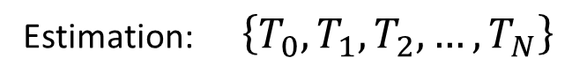
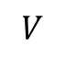

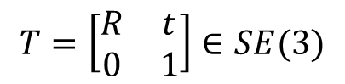
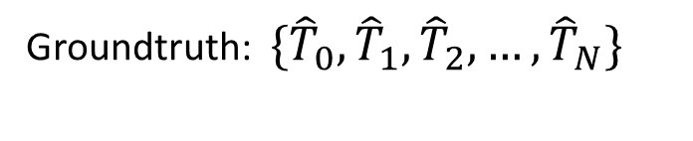

Trajectory Alignment
Two pose histories of the same object (e.g., camera)
Groundtruth: $\{{\hat{T}}_{0},{\hat{T}}_{1},{\hat{T}}_{2}, …,{\hat{T}}_{N}\}$
In the frame of the groundtruth provider W
Estimation: $\left\{T_{0},T_{1},T_{2}, …,T_{N}\right\}$
In arbitrary frame V and scale
$$T=\left[\begin{matrix}R & t \\ 0 & 1\end{matrix}\right]∈SE(3)$$
$$W$$
$${T_{k}=T}_{VE}$$
$${{\hat{T}}_{k}=T}_{WE}$$
$$V$$
Need to estimate a transformation between the two frames
Stereo/Laser: SE(3)
Monocular: SIM(3)
…
Notes:
Let’s first look at the problem of trajectory alignment.
Concretely, we have two series of poses. ….
What we want to estimate is actually a transformation between these two frames…
Someone may argue, well, this is easy, it is just a rigid body transformation, take the first pose of both and substract from the the rest.
This is not always the case, for example, for monocular setup, the scale is also unknown. We need some principled way of this task.

Slide 6







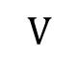

Trajectory Alignment: the formulation
Consider only positions (will see later why)
As a coordinate transformation problem
$$s$$
$$W$$
$$T_{WV}$$
$$V$$
Groundtruth: $\{{\hat{t}}_{0},{\hat{t}}_{1},{\hat{t}}_{2}, …,{\hat{t}}_{N}\}$
Estimation: $\left\{t_{0},t_{1},t_{2}, …,t_{N}\right\}$
As a point cloud alignment problem
$$\{R, s, t\}$$
$${\hat{t}}_{i}={s R}_{WV}t_{i}+t_{WV}$$
$$A=XB$$
Notes:
Let’s see first….
Usually we just use the position…
So we have a series of positions from the groundtruth and a series of positions from the SLAM algorithm, we need to find a sim3 transformation. To put it conceresly, we can transform the … by this equation
Of course we can also view it as a point cloud transformation problem, expressed in the same frame, the final equation is the same.
We can stack the equation for each of the translation, and we get a system of linear equations. Intuitively, the first thing we try is a least square solution.

Slide 7
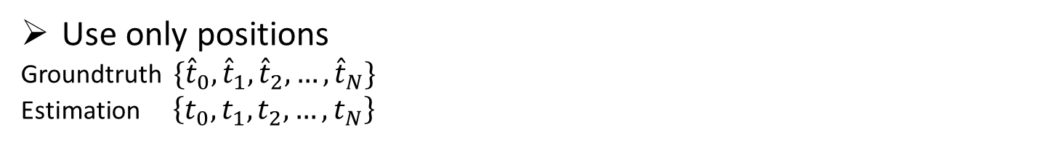
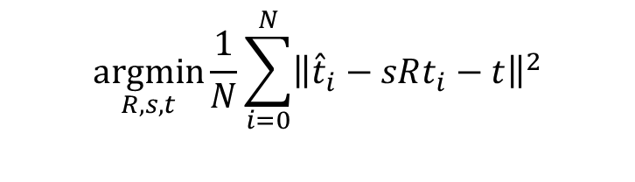
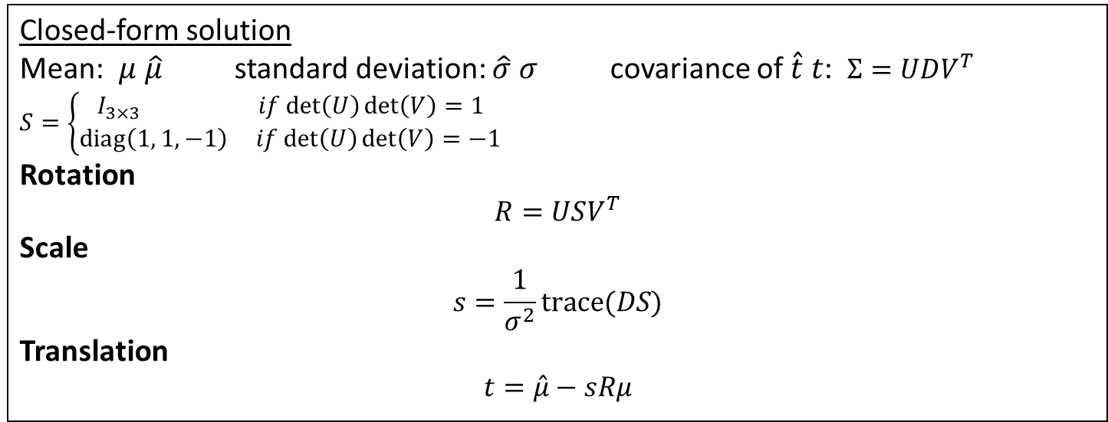
Trajectory Alignment
Use only positions
Groundtruth $\{{\hat{t}}_{0},{\hat{t}}_{1},{\hat{t}}_{2}, …,{\hat{t}}_{N}\}$
Estimation $\left\{t_{0},t_{1},t_{2}, …,t_{N}\right\}$
$$\underset{R,s,t}{argmin}{\frac{1}{N}\sum_{i=0}^{N}{{\left\|{\hat{t}}_{i}−sRt_{i}−t\right\|}^{2}}}$$
Umeyama "Least-squares estimation of transformation parameters between two point patterns," in IEEE Transactions on Pattern Analysis and Machine Intelligence, vol. 13, no. 4, pp. 376-380, Apr 1991.
Horn "Closed-form solution of absolute orientation using unit quaternions." JOSA A 4.4 (1987): 629-642.
Closed-form solution
Mean: $μ \hat{μ}$ standard deviation: $\hat{σ} σ$ covariance of $\hat{t} t$: $Σ=UDV^{T}$
$$S=\left\{\begin{matrix}I_{3×3} if\det\left(U\right)\det\left(V\right)=1 \\ \text{diag}\left(1, 1,−1\right) if\det\left(U\right)\det\left(V\right)=−1\end{matrix}\right.$$
Rotation
$$R=USV^{T}$$
Scale
$$s=\frac{1}{σ^{2}}\text{trace}(DS)$$
Translation
$$t=\hat{μ}−sRμ$$
Aligned poses
$$t_{i}^{′}=sRt_{i}+t, R_{i}^{′}=RR_{i}$$
Notes:
To put it conceretely , we have … the cost function is ….
This can be solved by Umeyama/Horn,

Slide 8
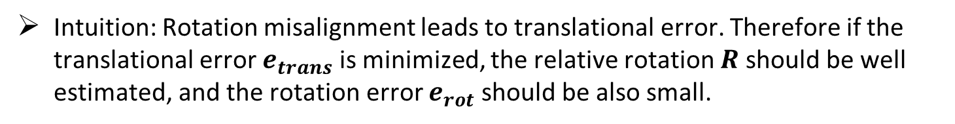
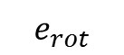
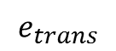
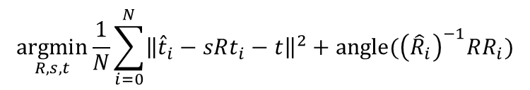
Alignment: Why not use rotation?
Why not also use rotational error, for example
$$\underset{R,s,t}{argmin}{\frac{1}{N}\sum_{i=0}^{N}{{\left\|{\hat{t}}_{i}−sRt_{i}−t\right\|}^{2}+\text{angle}({\left({\hat{R}}_{i}\right)}^{−1}RR_{i})}}$$
$$e_{trans}$$
$$e_{rot}$$
Intuition: Rotation misalignment leads to translational error. Therefore if the translational error $e_{trans}$ is minimized, the relative rotation $R$ should be well estimated, and the rotation error $e_{rot}$ should be also small.
=> It is sufficient to just minimize the translational error.
A comparative study
Salas et al. "Trajectory Alignment and Evaluation in SLAM: Horn’s Method vs Alignment on the Manifold."
=> Optimizing on the SE(3)/SIM(3) manifold, which minimizes both translational and rotational components, has very similar result with Horn’s method, which minimizes the translational error.
Notes:
So here is the question….
We can see that the translation error term depends on the rotation actually, therefore minimizing the translation error also help estimate the rotation. Intuitively, …..
A comparative study….

Slide 9
Outline
Quantitative Evaluation
Trajectory alignment
Performance metrics
Hand-Eye Calibration
Qualitative Evaluation
Practical Notes and Open Questions
Notes:
After the alignment, now we have two series of poses that are in the same coordinate frame, the remaining task is to summarize the performance metric.

Slide 10
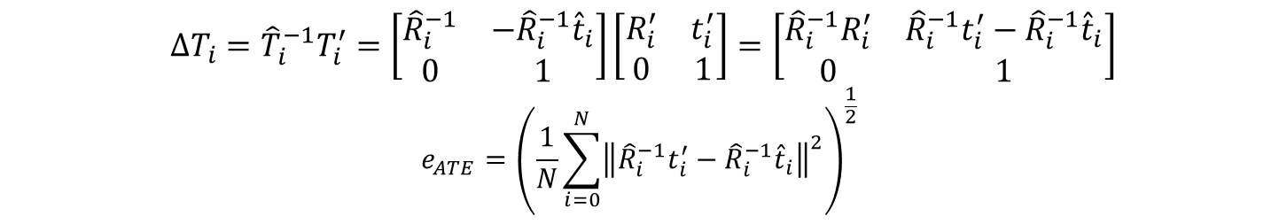
Absolute Trajectory Error (ATE)
From aligned poses: ${\left\{{\hat{T}}_{i}\right\}}_{i=0}^{N}$ ${\left\{T_{i}^{′}\right\}}_{i=0}^{N}$
Sturm et al. "A benchmark for the evaluation of RGB-D SLAM systems." Intelligent Robots and Systems (IROS), 2012 IEEE/RSJ International Conference on. IEEE, 2012.
$$ΔT_{i}={\hat{T}}_{i}^{−1}T_{i}^{′}=\left[\begin{matrix}{\hat{R}}_{i}^{−1} & −{\hat{R}}_{i}^{−1}{\hat{t}}_{i} \\ 0 & 1\end{matrix}\right]\left[\begin{matrix}R_{i}^{′} & t_{i}^{′} \\ 0 & 1\end{matrix}\right]=\left[\begin{matrix}{\hat{R}}_{i}^{−1}R_{i}^{′} & {\hat{R}}_{i}^{−1}t_{i}^{′}−{\hat{R}}_{i}^{−1}{\hat{t}}_{i} \\ 0 & 1\end{matrix}\right]$$
$$e_{ATE}={\left(\frac{1}{N}\sum_{i=0}^{N}{{\left\|{\hat{R}}_{i}^{−1}t_{i}^{′}−{\hat{R}}_{i}^{−1}{\hat{t}}_{i}\right\|}^{2}}\right)}^{\frac{1}{2}}$$
Reflect the overall position error of the whole trajectory.
…
…
…
Absolute error can be deceptive
Depending on where the error occurs
E.g., rotation error at the beginning is likely to lead to large ATE
Notes:
The first metric I am going to talk about is the absolute trajectory error.
Calculate the relative transformation between the groundtruth and the estimation, and use the translation part as the error.
Intuitively, RMSE error
However,….

Slide 11
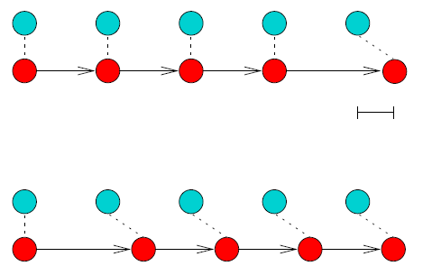
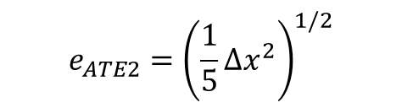
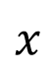
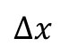
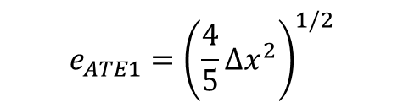
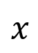
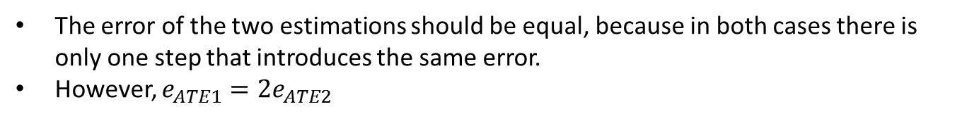
The problem with ATE
Example: 1D case
estimation
groundtruth
Kümmerle et al. "On measuring the accuracy of SLAM algorithms." Autonomous Robots 27.4 (2009): 387-407.
Estimation 1: Error occurs early
$$Δx$$
Estimation 2: Error occurs at last
$$x$$
$$x$$
$$e_{ATE1}={\left(\frac{4}{5}Δx^{2}\right)}^{1/2}$$
$$e_{ATE2}={\left(\frac{1}{5}Δx^{2}\right)}^{1/2}$$
The error of the two estimations should be equal, because in both cases there is only one step that introduces the same error.
However, $e_{ATE1}=2e_{ATE2}$
Notes:
One intuitive change to this is to use the relative error from the ….

Slide 12
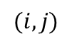
Relative Error
As a function of traveled distance $d$
Kümmerle et al. "On measuring the accuracy of SLAM algorithms." Autonomous Robots 27.4 (2009): 387-407.
Geiger et al. "Are we ready for autonomous driving? the kitti vision benchmark suite." Computer Vision and Pattern Recognition (CVPR), 2012 IEEE Conference on. IEEE, 2012.
1. Collect frames that are distance $d$ away
Groundtruth
The distance is calculated along the trajectory.
$$(i,j)$$
Continue for all the frames
$M(d)=\{(i,j)\}$ contains all frame pairs that are distance $d$ away along the trajectory.
Notes:
Now it is more popular to use the relative error. And the relative error is usually calculated for a certain distanct (10, 50, 100 …. As you define)

Slide 13
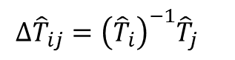
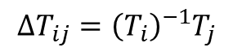
Relative Error
As a function of traveled distance $d$
1. Collect frames that are distance $d$ away
$M(d)=\{(i,j)\}$ contains all frame pairs that are distance $d$ away along the trajectory.
2. For each pair $\left(i,j\right)∈M(d)$
$$Δ{\hat{T}}_{ij}={\left({\hat{T}}_{i}\right)}^{−1}{\hat{T}}_{j}$$
Groundtruth
$$ΔT_{ij}={\left(T_{i}\right)}^{−1}T_{j}$$
Estimation
Compare the relative transformation
$$e_{trans_{ij}}=\text{trans}\left({\left(Δ{\hat{T}}_{ij}\right)}^{−1}{ΔT}_{ij}^{′}\right), e_{rot_{ij}}=\text{angle}\left({\left(Δ{\hat{T}}_{ij}\right)}^{−1}{ΔT}_{ij}^{′}\right)$$
Collect the relative error for all the pairs in $M(d)$
$${e_{trans}\left(d\right)=\{e}_{trans_{ij}}\}, {e_{rot}\left(d\right)=\{e}_{rot_{ij}}\},$$
All the possible relative errors along the trajectory!

Slide 14
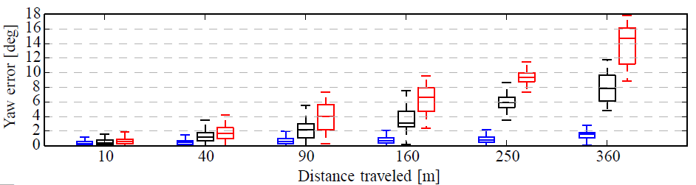
Relative Error
As a function of traveled distance $d$
1. Collect frames that are distance $d$ away
$M(d)=\{(i,j)\}$ contains all frame pairs that are distance $d$ away along the trajectory.
2. For each pair $\left(i,j\right)∈M(d)$
Compare the relative transformation
$$e_{trans_{ij}}=\text{trans}\left({\left(Δ{\hat{T}}_{ij}\right)}^{−1}{ΔT}_{ij}^{′}\right), e_{rot_{ij}}=\text{angle}\left({\left(Δ{\hat{T}}_{ij}\right)}^{−1}{ΔT}_{ij}^{′}\right)$$
Collecting the relative error for all the pairs in $M(d)$
$${e_{trans}\left(d\right)=\{e}_{trans_{ij}}\}, {e_{rot}\left(d\right)=\{e}_{rot_{ij}}\},$$
3. Repeat step 1 and 2 for different distances $d$.
Method 1
Method 2
Method 3
local,
short-term
global,
long-term
Notes:
Note that here we can have the boxplot because for each travel distance d, we calculate all the possible errors along the trajectory, from which we can summarize meaningful statistics.

Slide 15
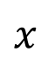
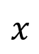
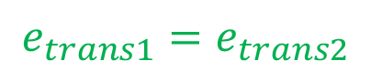

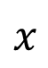
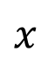
ATE vs. Relative Error
Absolute error
$$x$$
$$x$$
$$e_{ATE1}=2e_{ATE2}$$
Relative error
$$x$$
$$x$$
$$e_{trans1}=e_{trans2}$$
Notes:
One last thing is that when using the relative error metrics, we do not need to necessarily do trajectory alignment. Only when the scale is unknown, we need to apply the method to estimate the scale.

Slide 16
Outline
Quantitative Evaluation
Trajectory alignment
Performance metrics
Hand-Eye Calibration
Qualitative Evaluation
Practical Notes and Open Questions

Slide 17
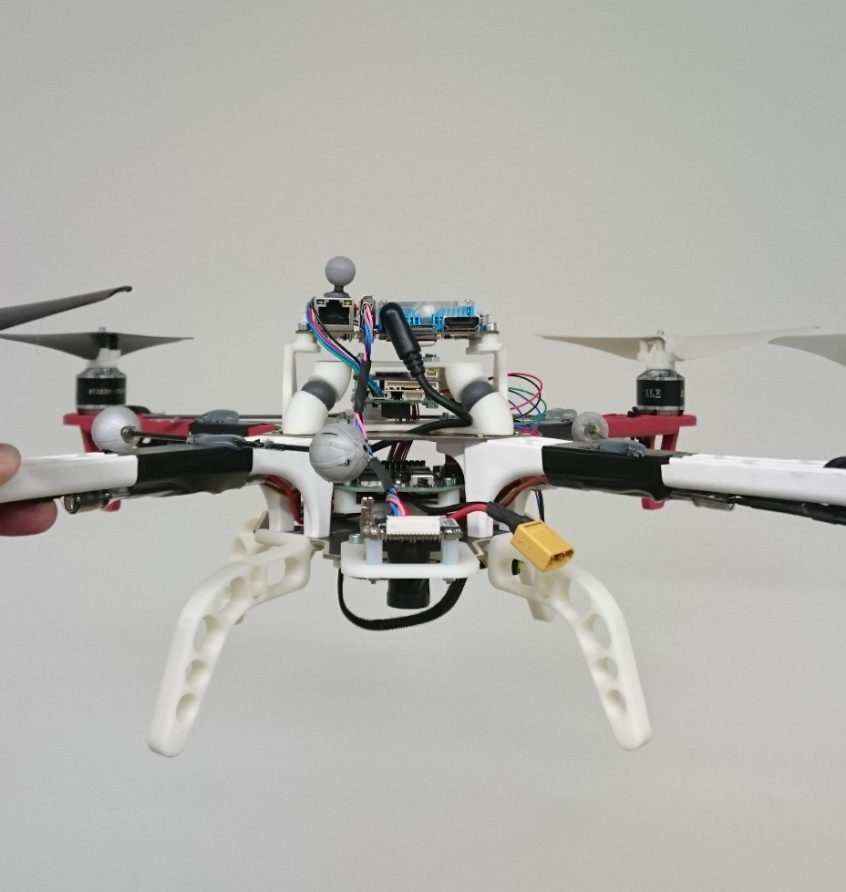
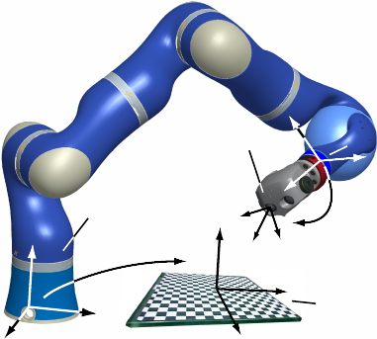
Hand-Eye Calibration: Examples
hand
eye
Hand: robot arm end-factor
Eye: camera
Hand: center of mass of the markers
Eye: camera
Hand-Eye Calibration: calculate the transformation between the hand and the eye
Notes:
So what is an hand-eye calibration, why it is called hand-eye?
The term comes from a robotic manipulator, the end factor of the arm is hand and the …. Is eye. The transformation between the handeye is essential if you want to use the …. to move something based on the camera images.
In terms of visual SLAM and odometry, taking the quadrotor on the right part as an example. The hand is located as the center of the markers and eye is again the camera.
The task of hand-eye calibration is calculate the transformation between the hand and eye. In the following use …

Slide 18
Hand-Eye Calibration: The Problem
Final Goal: We want to know how good the estimation fits the groundtruth.
Hand-eye calibration: find the relative transformation between the hand and the eye in order to get the groundtruth poses of the eye.
Raw data
The problem
Groundtruth Poses => Hand
The (groundtruth) hand poses and the (estimated) eye poses describe different coordinate frames, and cannot be compared with each other directly .
Estimated Poses => Eye
It is a different problem from trajectory alignment.
Notes:
At the first look, we may say that the groundtruth is a trajectory and the eye poses is also a trajectory , can we directly align them?
The answer is no, they are not only in different frames but also describe different things. An intuitive example is ….
In this situation, there is no way one can align the ….
We will see how we can solve it now.

Slide 19

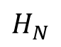
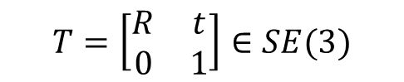
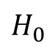
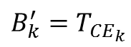
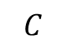
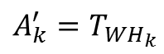

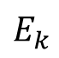
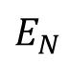

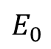
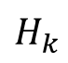
Hand-Eye Calibration: Problem Setup
$${A_{k}^{′}=T}_{WH_{k}}$$
$$T=\left[\begin{matrix}R & t \\ 0 & 1\end{matrix}\right]∈SE(3)$$
$$H_{k}$$
$$W$$
$$H_{0}$$
$$H_{N}$$
Groundtruth provider
$${X=T}_{HE}$$
$$E_{0}$$
$$E_{k}$$
$$E_{N}$$
$${B_{k}^{′}=T}_{CE_{k}}$$
$$C$$
With correct scale from the checkerboard size.
Calibration target
Notes:
The hand-eye calibration is usually done in this setup. The camera observes and calibration target with known size. Then we can calculate the eye poses in the calibration target frame. Meanwhile we also know the hand poses in the frame of the groundtruth provider.

Slide 20

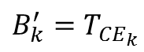
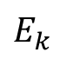
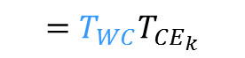
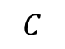
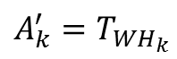
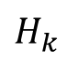
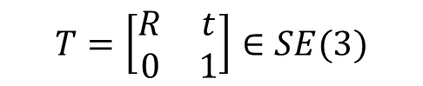
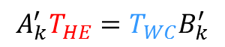





Hand-Eye Calibration: Two Formulations
$${A_{k}^{′}=T}_{WH_{k}}$$
$$T=\left[\begin{matrix}R & t \\ 0 & 1\end{matrix}\right]∈SE(3)$$
$$H_{k}$$
$$W$$
$${X=T}_{HE}$$
$$E_{k}$$
$$T_{WE_{k}}$$
$${B_{k}^{′}=T}_{CE_{k}}$$
$${Z=T}_{WC}$$
$$C$$
Using poses at the same time
$$T_{WH_{k}}T_{H_{k}E_{k}}=T_{WE_{k}}$$
$$=T_{WC}T_{CE_{k}}$$
$$A_{k}^{′}T_{HE}=T_{WC}B_{k}^{′}$$
$$A^{′}X=ZB′$$

Slide 21














Hand-Eye Calibration: Two Formulations
$$W$$
$$H_{i}$$
$$A_{ij}=T_{H_{i}H_{j}}$$
$$H_{j}$$
$${X=T}_{HE}$$
$$E_{i}$$
$$E_{j}$$
$$B_{ij}=T_{E_{i}E_{j}}$$
$$T_{H_{i}E_{j}}$$
$$C$$
Using poses of different times
$$A_{ij}T_{H_{j}E_{j}}=T_{H_{i}E_{j}}$$
$$=T_{H_{i}E_{i}}B_{ij}$$
$$A_{ij}T_{HE}=T_{HE}B_{ij}$$
$$AX=XB$$

Slide 22













Hand-Eye Calibration: Two Formulations
$${A_{k}^{′}=T}_{WH_{k}}$$
$$W$$
$$H_{0}$$
$$A_{ij}=T_{H_{i}H_{j}}$$
$$H_{N}$$
$${X=T}_{HE}$$
$$E_{0}$$
$$E_{N}$$
$$B_{ij}=T_{E_{i}E_{j}}$$
$${B_{k}^{′}=T}_{CE_{k}}$$
$${Z=T}_{WC}$$
$$C$$
Using estimation of different times
$$A_{ij}T_{H_{j}E_{j}}=T_{H_{i}E_{i}}B_{ij}$$
$$A_{ij}T_{HE}=T_{HE}B_{ij}$$
Using estimation at the same time
$$A_{k}^{′}T_{H_{k}E_{k}}=T_{WC}B_{k}^{′}$$
$$A_{k}^{′}T_{HE}=T_{WC}B_{k}^{′}$$
$$AX=XB$$
$$A^{′}X=ZB′$$

Slide 23

Hand-Eye Calibration: Method
Rich literature on hand-eye calibration
Strobl et al. “Optimal hand-eye calibration” (IROS 2006)
Others: global optimal solution, etc.
Our method
Obtain initial estimation of $X$ from$AX=XB$ using an efficient linear algorithm.
Optimize for $X, Z$ simultaneously from $A^{′}X=ZB′$ by minimizing the reprojection error
Able to use the raw measurements directly (i.e., corners)
Reprojection error can give an indication of the calibration quality
Mueggler et al. "The Event-Camera Dataset and Simulator: Event-based Data for Pose Estimation, Visual Odometry, and SLAM." arXiv preprint arXiv:1610.08336 (2016).
Notes:
Literature … etc
In the following we introduce how our ….
We first
Then
I use our mthod as an example because I think it has some advantages, first, second….
Also it covers both of the formulations we talked about, so it is also good to ….

Slide 24

Hand-Eye Calibration: Step 1
Linear algorithm using
Classic method from Tsai et al. (1989)
Basically two linear least-square problems
Estimate the rotation first
Then estimate the translation using the estimated rotation
Advantages: very efficient
$$AX=XB$$
Tsai et al. "A new technique for fully autonomous and efficient 3D robotics hand/eye calibration." IEEE Transactions on robotics and automation 5.3 (1989): 345-358.
=> Provide an initial value for the following optimization
Notes:
But estimating rotation and translation separately usually does not give very good accuracy.

Slide 25


Hand-Eye Calibration: Step 1
Linear algorithm using
Classical method from Tsai et al. (1989)
Basically two linear least-square problems
$$AX=XB$$
1. Rotation
Use an angle-axis representation
$$\vec{r}=2\sin{\frac{θ}{2}}{\left[n_{1},n_{2},n_{3}\right]}^{T}$$
Solving the equation system
$$\text{\{}\text{Skew}\left({\vec{r}}_{Hij}+P_{Eij}\right){\vec{r}′}_{HE}={\vec{r}}_{Eij}−{\vec{r}}_{Hij}\}$$
$${\vec{r}}_{HE}=\frac{2 {\vec{r}}_{HE}^{′} }{\sqrt{1+{\left|{\vec{r}}_{HE}^{′}\right|}^{2}}}$$
Then we can convert ${\vec{r}}_{HE}$ to $R_{HE}$.
2. Translation
From the formulation
$$A_{ij}T_{HE}=T_{HE}B_{ij}$$
use the translation part:
{$\left(R_{Hij}−I_{3×3}\right)t_{HE}=R_{HE}T_{Eij}−t_{Hij}\}$
We can then solve the linear equation system for $t_{HE}.$
Tsai et al. "A new technique for fully autonomous and efficient 3D robotics hand/eye calibration." IEEE Transactions on robotics and automation 5.3 (1989): 345-358.

Slide 26














Hand-Eye Calibration: Step 2
Nonlinear optimization using
$$A^{′}X=ZB′$$
$$X,Z=\underset{X,Z}{\text{argmin}}{\sum_{kn}{{\left(x_{kn}−{\hat{x}}_{kn}\right)}^{2}}}$$
$${A_{k}^{′}=T}_{WH_{k}}$$
observed corners
predicted corners
$$W$$
$$H_{k}$$
camera intrinsics
$${X=T}_{HE}$$
$${\hat{x}}_{kn}=f\left({\hat{B}}_{k}^{′},P_{n},K\right)$$
$$=f(Z^{−1}A_{k}^{′}X, P_{n},K)$$
$$E_{k}$$
$${B_{k}^{′}=T}_{CE_{k}}$$
$$T_{CE_{k}}$$
$$P_{n}$$
Minimize the reprojection error of all the corners.
$${Z=T}_{WC}$$
$$C$$

Slide 27



Recap: Towards Reproducible Experiments
VO
SLAM
estimation
Evaluation
GPS positions
3D laser scan
Motion capture poses
……
Hand-Eye
Transformation
groundtruth
Hand-Eye Calibration
Notes:
Reproducible experiments is crucial for reliably evaluate and comparing existing methods.
We have …
We want …
From camera
From groundtruth provider…
Our first problem,
Our second problem,
In this talk we will talk about…

Slide 28
What if we have no groundtruth?

Slide 29


Qualitative: Structure Consistency
Revisit the same place
Engel et al. "Direct sparse odometry." arXiv preprint arXiv:1607.02565 (2016).
Use prior information of the environment
Planar scenes
Vertical relations
……

Slide 30

Qualitative: Inspect Trajectories
Zhang et al. "Benefit of large field-of-view cameras for visual odometry." Robotics and Automation (ICRA), 2016 IEEE International Conference on. IEEE, 2016.

Slide 31
Practical Notes
Randomness in the algorithm
RANSAC
Feature selection
......
Run multiple times (~50) and obtain meaningful statistics.
Modern VO/SLAM algorithms are complicated
Loop closure
Relocalization
Make sure the algorithms can be fairly compared.
e.g., There is no point comparing a visual odometry algorithm with a full SLAM pipeline.

Slide 32
Open Issues
Trajectory alignment may be not reproducible
Different methods
Different number of frames used for alignment
……
Fine details of the evaluation method should be reported for reproducibility.
VO/SLAM usually have many parameters
Have great impacts on the result
Requires familiarity with the algorithm details to tune
Report/publish also the parameters.
VO/SLAM algorithm should be able to adapt its parameters automatically.

Slide 33
Summary
Hand-Eye calibration: convert the groundtruth hand poses to the eye poses
Trajectory alignment: put the groundtruth and the estimation in the same coordinate frame and scale.
Evaluation
Quantitative: use relative metrics if possible
Qualitative: inspect structure and trajectory

